Slide 1
Find a Location for Bill’s Taco Town

Slide 2
The Problem
Bill has just moved to Sun Valley, Los Angeles CA
Bill makes Tacos
Tacos are not that great
Find area with least amount of taco competition

Slide 3
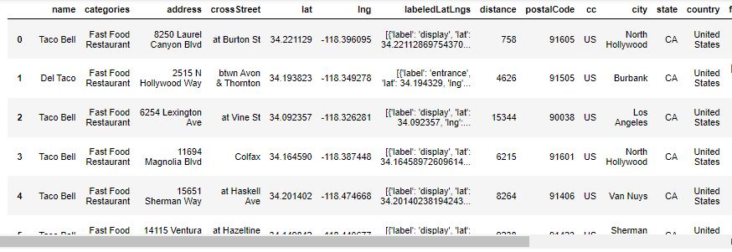
Data Source
geo location from geopy.geocoders
Foursquare API
Scikit Learn and Pandas

Slide 4
Methodology
Identify the geo location of Bill
Tap into the Foursquare API
Perform cleansing and transform
Apply K-means clustering
Visualize
Draw Conclusions

Slide 5
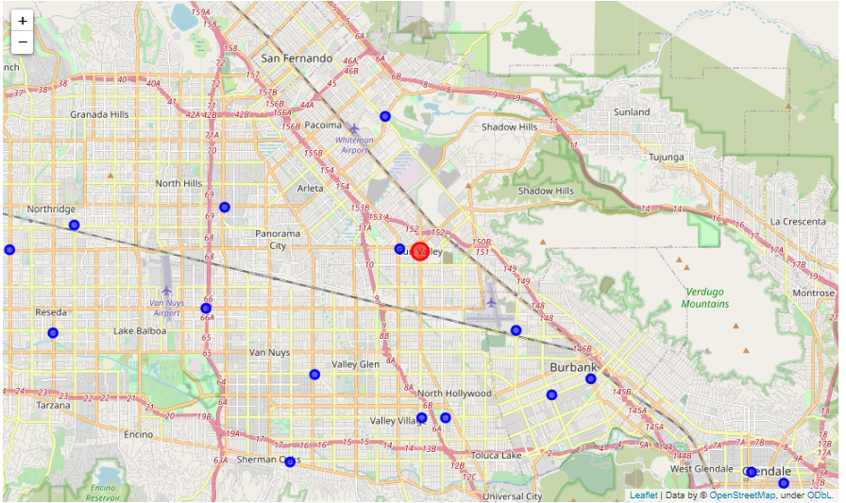
Analysis: Bills Location and Nearby TaCOS
Extremely high Taco Density

Slide 6
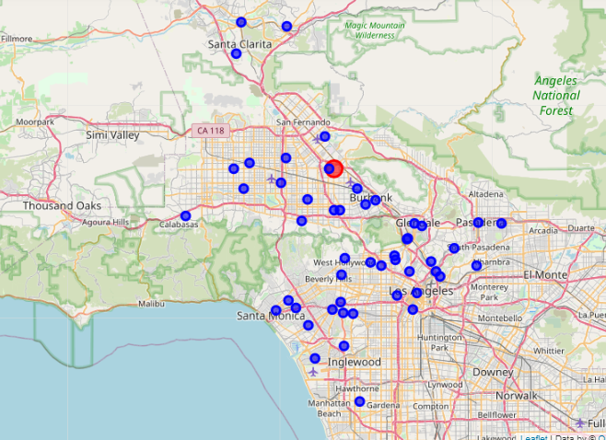
Analysis: Greater Los AnGeles Taco Density
Still very high

Slide 7
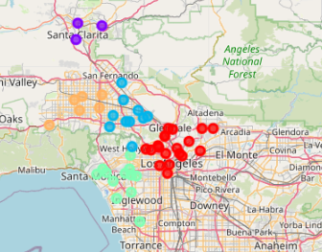
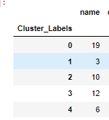
Apply Clustering
Purple Area 1 looks to be less dense

Slide 8
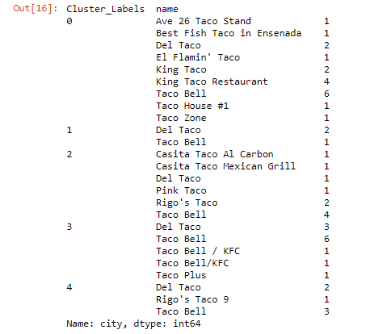
What the Competition ?
Cluster 1 is mostly fast food. Still appears to be the best choice

Slide 9
Results and Conclusion
Cluster 1 Santa Clarita Valley best location
3 Taco Venues all fast food
total population of 210k
Venues are far a part
19 mile commute for Bill

